Slide 1
Simple Regression Method 3
Apply least squares to minimize the sum of squared differences in a linear regression model.

Slide 2
Introduction
Simple Regression assesses the impact of one independent variable on a dependent variable.
Importance: Essential for understanding linear relationships, widely used in various disciplines for straightforward analysis.
Example: Examining the correlation between study hours and test scores in educational research.

Slide 3
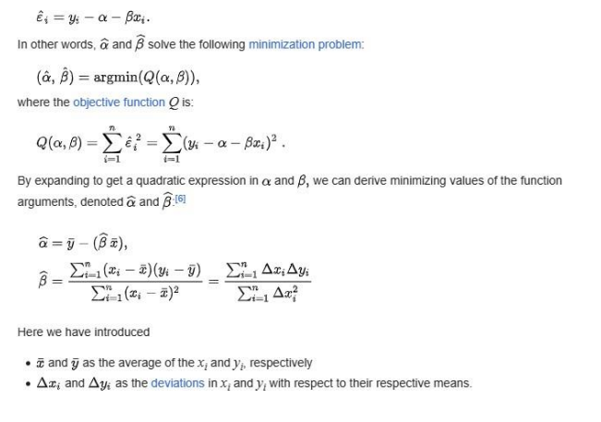
Formulation and computation
The goal is to find estimated values and for the parameters α and β which would provide the "best" fit in some sense for the data points.
As mentioned in the introduction, in this article the "best" fit will be understood as in the least-squares approach: a line that minimizes

Slide 4


Interpretation
Relationship with the sample covariance matrix The solution can be reformulated using elements of the covariance matrix:
Where:
rxy is the sample correlation coefficient between x and y
sx and sy are the uncorrected sample standard deviations of x and y
sample variance and sample covariance, respectively
Final Formula for rxy:

Slide 5
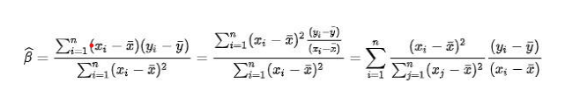
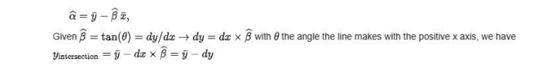
Interpretation:
Interpretation about the slope:
Interpretation about the intercept:

Slide 6
Applications of the Project
Economics and Finance:
Application: Analyzing how interest rate changes influence consumer spending for economic forecasting.
Health Sciences:
Application: Studying the correlation between physical activity levels and blood pressure in health research.
Marketing and Sales:
Application: Assessing the effectiveness of advertising campaigns on monthly sales revenue in marketing.

Slide 7
THANK YOU!!!!

